Slide 1

Home
SQL PROJECT
AIRLINE RESERVATION SYSTEM
INDIGO AIRLINES(2022-24)
Page 01

Slide 2
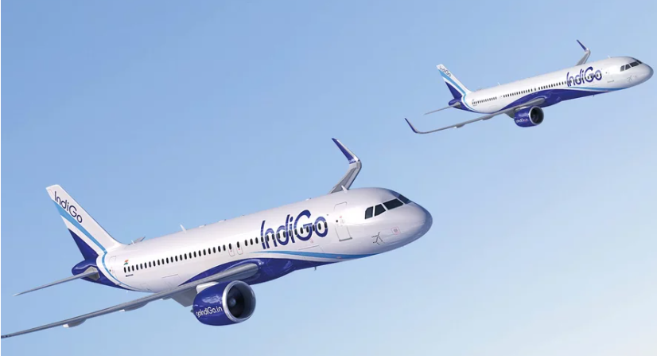
ABSTRACT
The Airline Reservation System is a database-driven project designed to simplify and automate the process of managing flight bookings. Built using SQL, the system stores and handles essential data such as passenger details, flight schedules, ticket reservations, cancellations, and payments. It ensures data consistency, quick retrieval of information, and secure management of records. The project demonstrates the use of relational database concepts like tables, primary and foreign keys, normalization, and SQL queries to manage real-world airline operations efficiently. This system enhances reliability, reduces manual workload, and provides a foundation for scalable airline management solutions.
Page 02

Slide 3
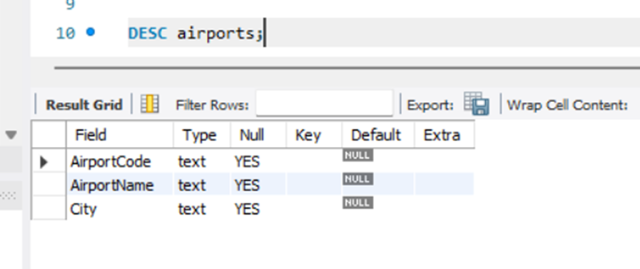
STRUCTURE OF TABLES
Create database AirlineReservationSystem;
USE AirlineReservationSystem;
1)AIRPORT TABLE
-- Airports table
CREATE TABLE Airports (
AirportID INT,
AirportName VARCHAR(100),
City VARCHAR(100),
Country VARCHAR(100)
);
Page 03

Slide 4
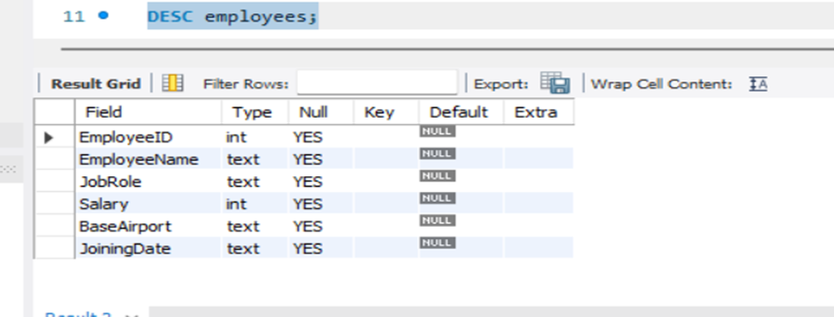
STRUCTURE OF TABLES
2)EMPLOYEE TABLE
-- Employees table
CREATE TABLE Employees (
EmployeeID INT,
EmployeeName VARCHAR(100),
JobRole VARCHAR(100)
Salary INT,
BaseAirport VARCHAR(100),
JoiningDate DATE
);
Page 04

Slide 5
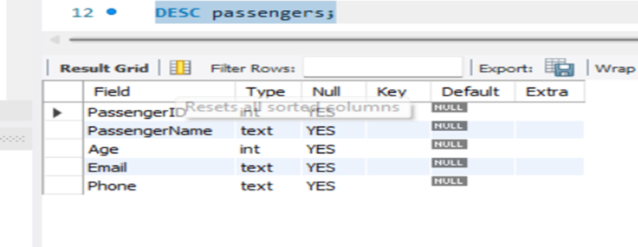
STRUCTURE OF TABLES
3)PASSENGERS TABLE
-- Passengers table
CREATE TABLE Passengers (
PassengerID INT,
PassengerName VARCHAR(100),
Age INT,
Email VARCHAR(150),
Phone VARCHAR(20));
Page 05

Slide 6
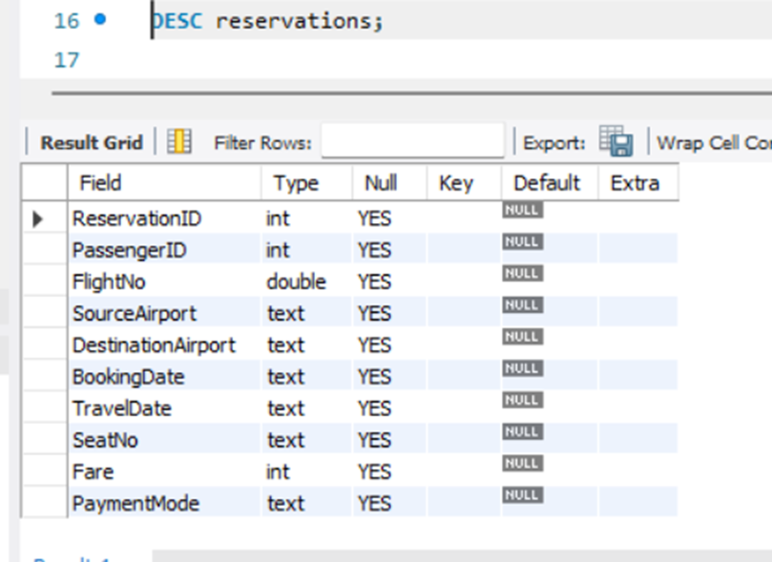
STRUCTURE OF TABLES
4)RESERVATIONS
TABLE
-- Reservations table
CREATE TABLE Reservations (
ReservationID INT,
PassengerID INT,
FlightNo VARCHAR(50),
SourceAirport VARCHAR(100),
DestinationAirport VARCHAR(100),
BookingDate DATE,
TravelDate DATE,
SeatNo VARCHAR,
Fare VARCHAR,
PaymentMode VARCHAR(20)
);
Page 06

Slide 7
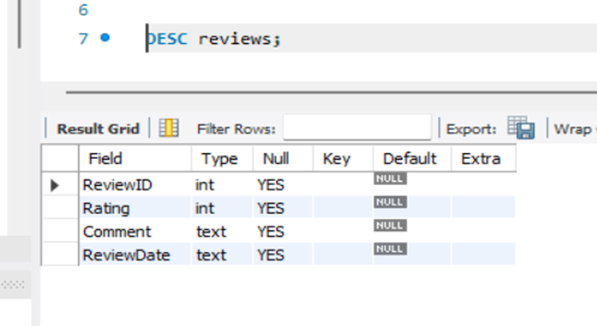
STRUCTURE OF TABLES
5)REVIEW TABLE
-- Reviews table
CREATE TABLE Reviews (
ReviewID INT,
Rating INT,
Comment VARCHAR(20),
ReviewDate DATE
);
Page 07

Slide 8
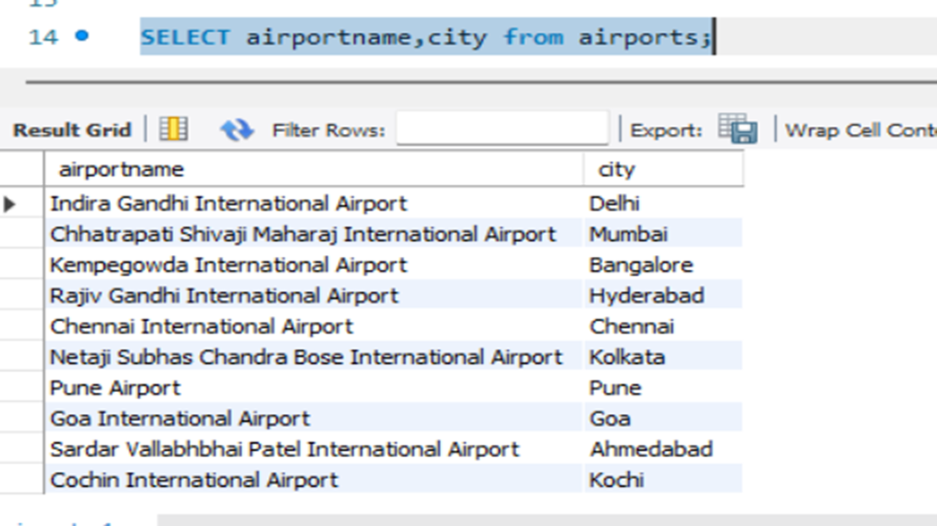
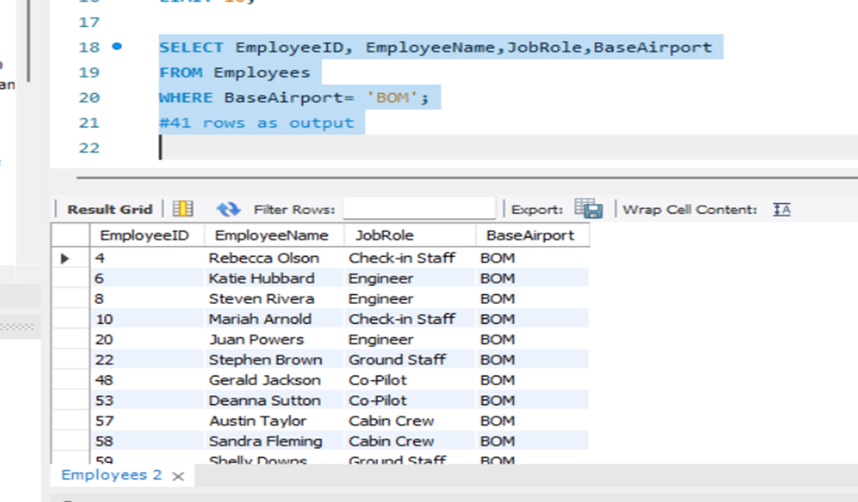
SQL BASIC QUERIES- SELECT
Q. Displaying airportname and city .
Q. Displaying Employeedetails where BaseAirport=’BOM’
02.
01.
Page 08

Slide 9
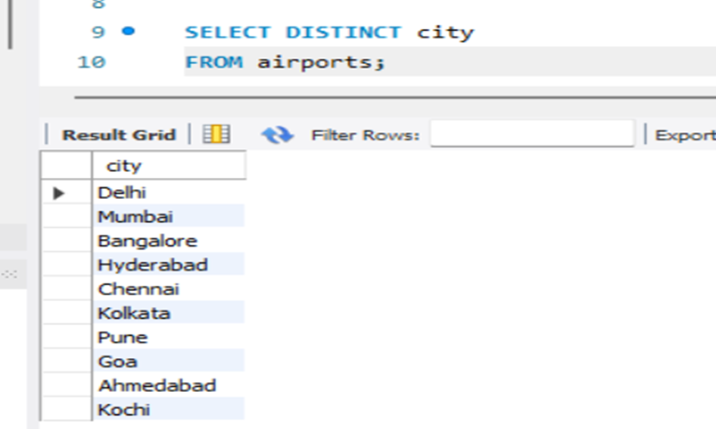
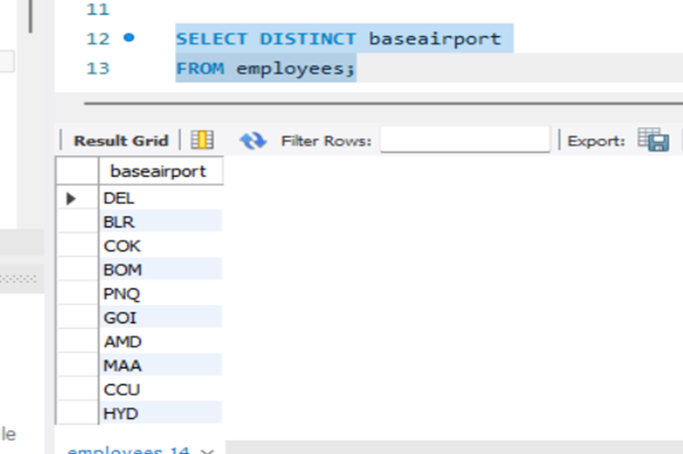
DISTINCT
Q. Distinct city
Q. Distinct BaseAirport
02.
01.
Page 09

Slide 10
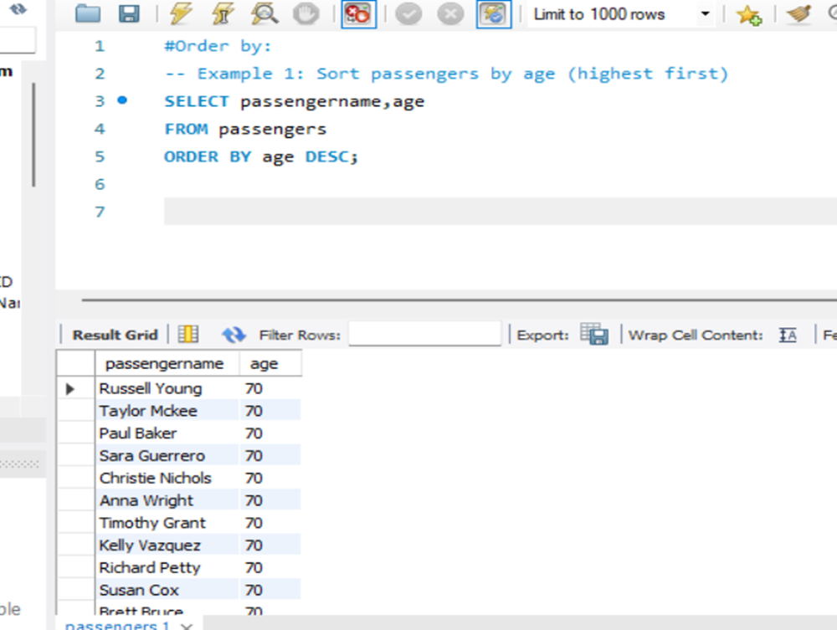
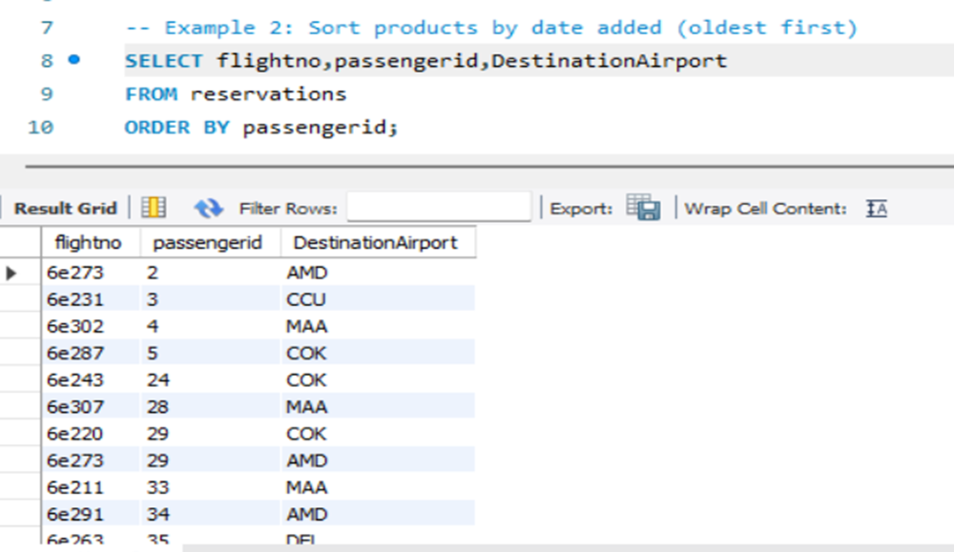
ORDER BY
Q. Sort passengers by age(highest to lowest)
Q. Sort reservations by passengers(oldest first)
02.
01.
Page 10

Slide 11
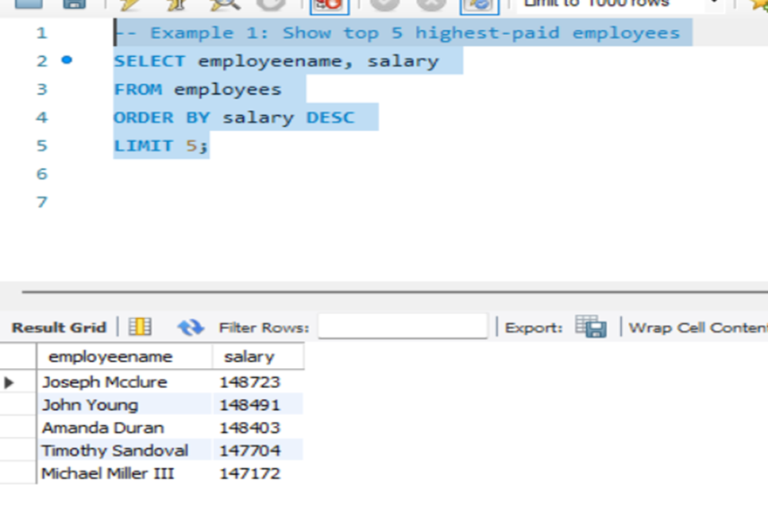
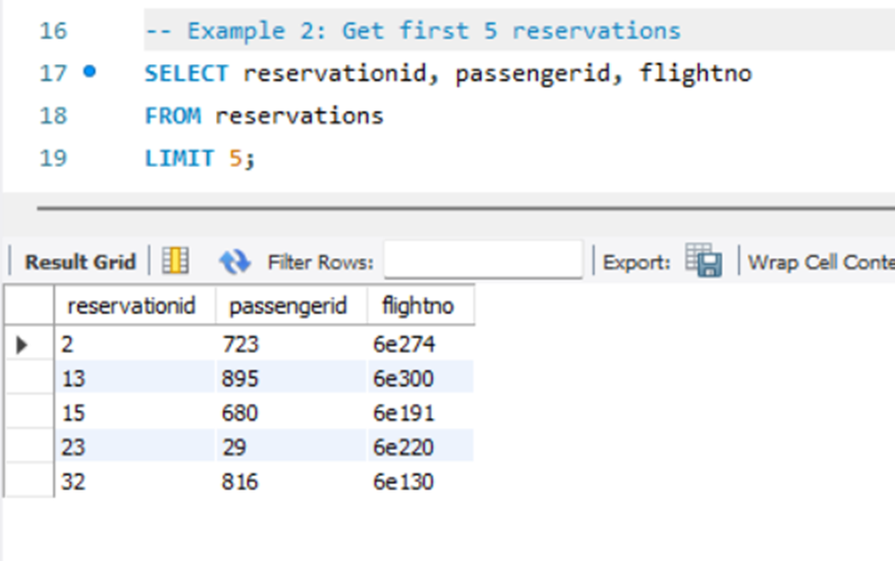
LIMIT
Q. Top 5 highest paid employees
Q. Get first 5 reservations
02.
01.
Page 11

Slide 12

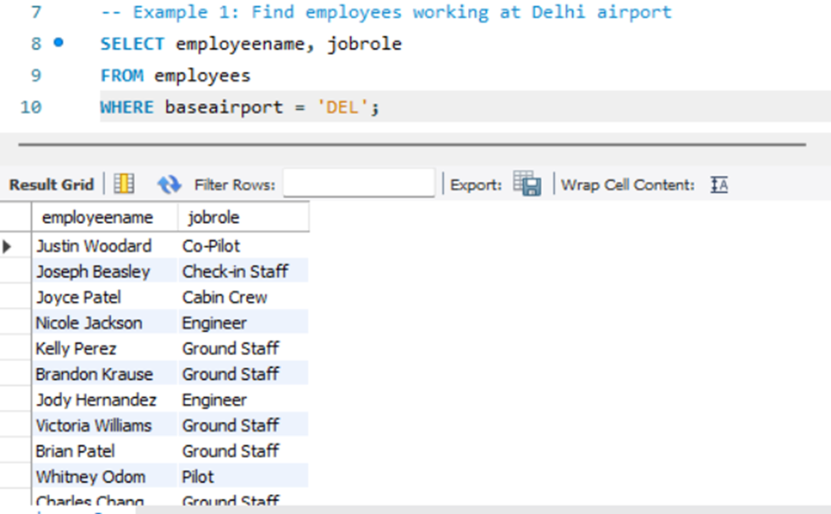
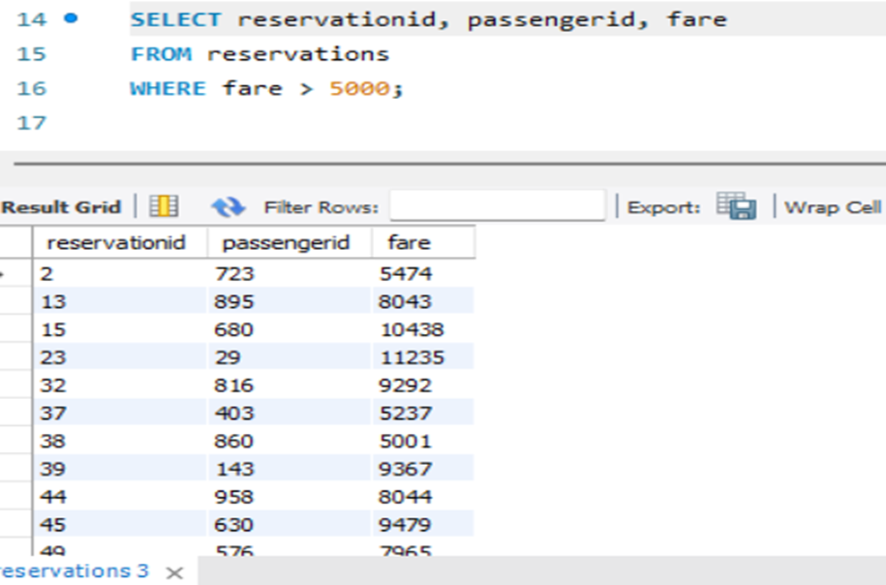
FILTERING - WHERE
Q. Find employees working at Delhi Airport
Q. Find fare greater than 5000
02.
Acknowledge the presence of competitors & potential challenges ahead
01.
Page 12

Slide 13
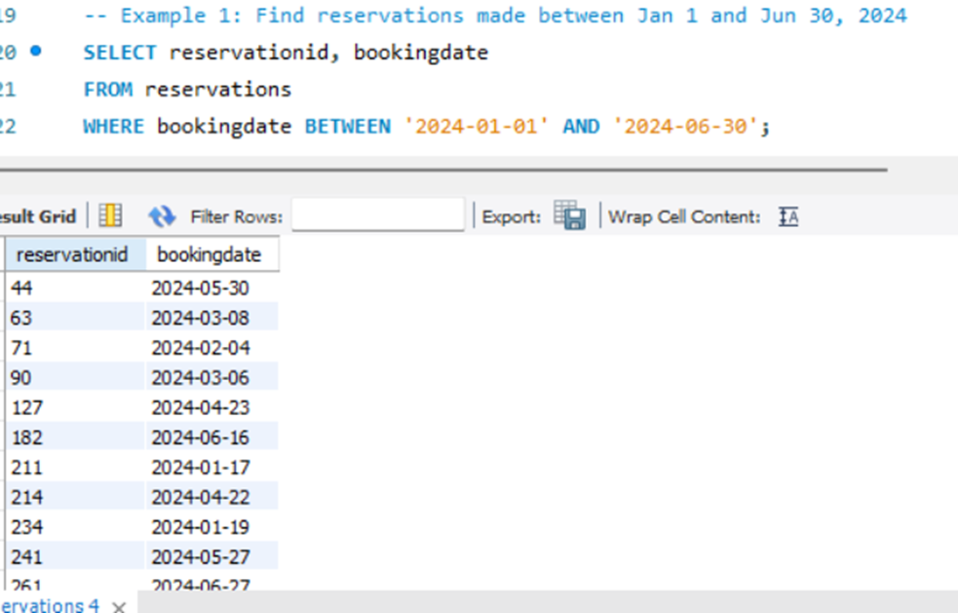
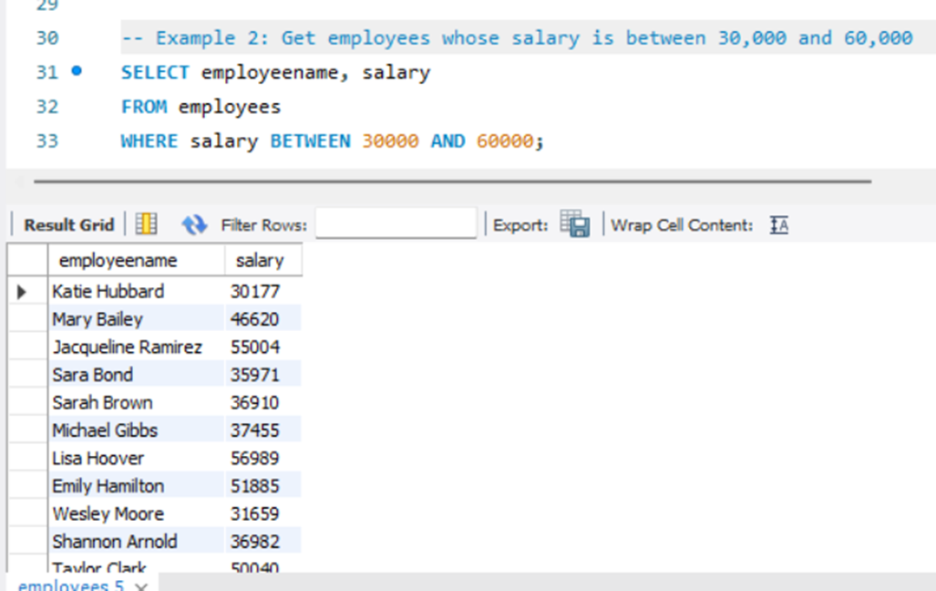
BETWEEN
Q. Get employees whose salary is between 30000 & 60000
Q. Find reservations made between Jan 1 to Jun 30,2024
02.
01.
Page 13

Slide 14
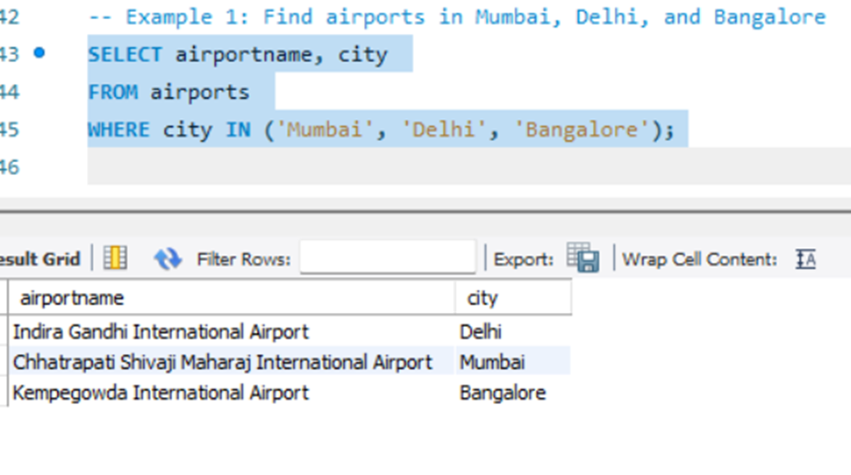
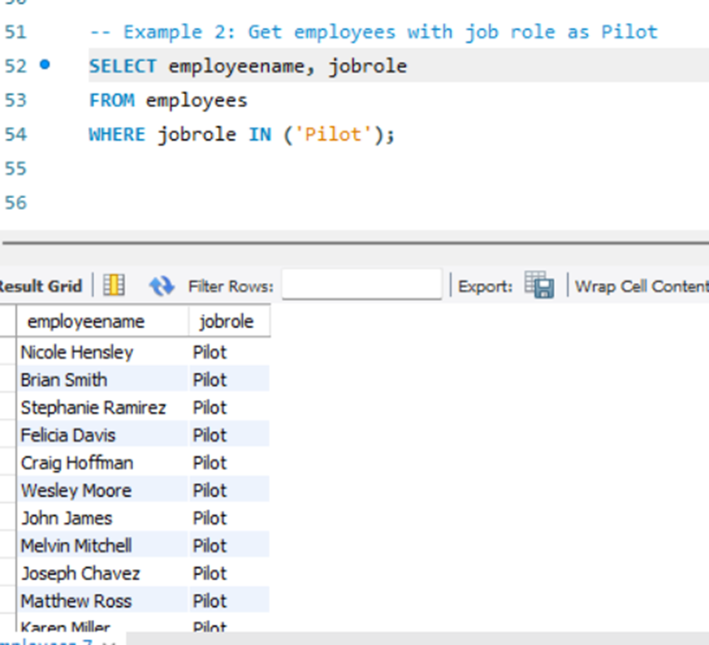
IN
Q. Find Airports in Mumbai,Delhi and Bangalore
Q. Get employees with JobRole as ‘Pilot’
02.
Acknowledge the presence of competitors & potential challenges ahead
01.
Page 14

Slide 15
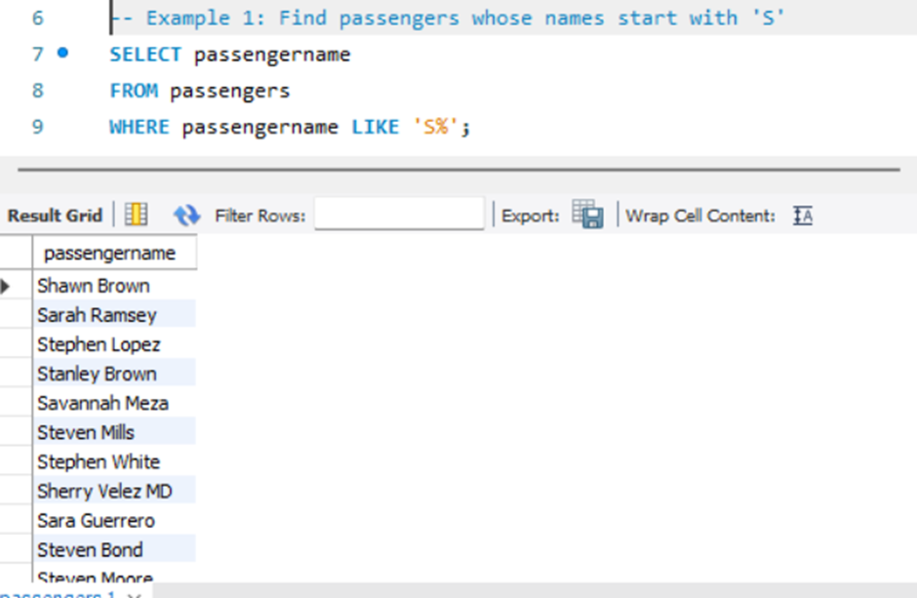
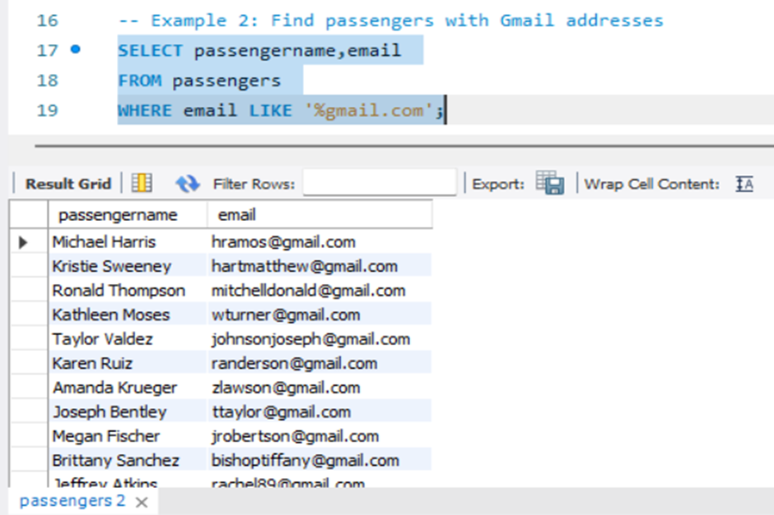
LIKE
Q. Find passengers whose name starts with ‘s’
Q. Find passengers with gmail addresses
02.
01.
Page 15

Slide 16
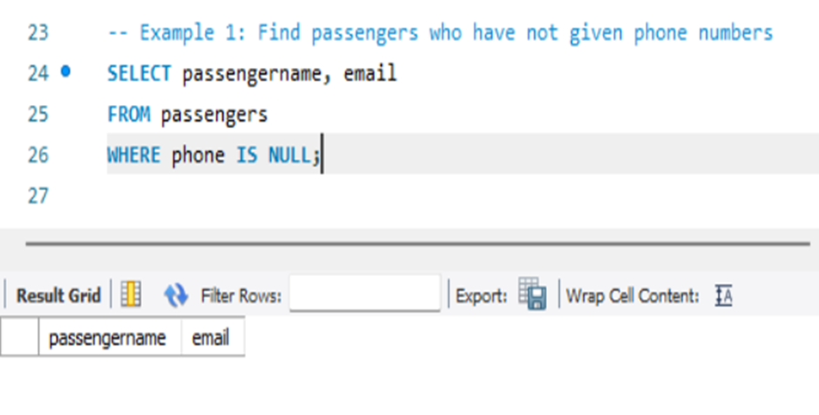
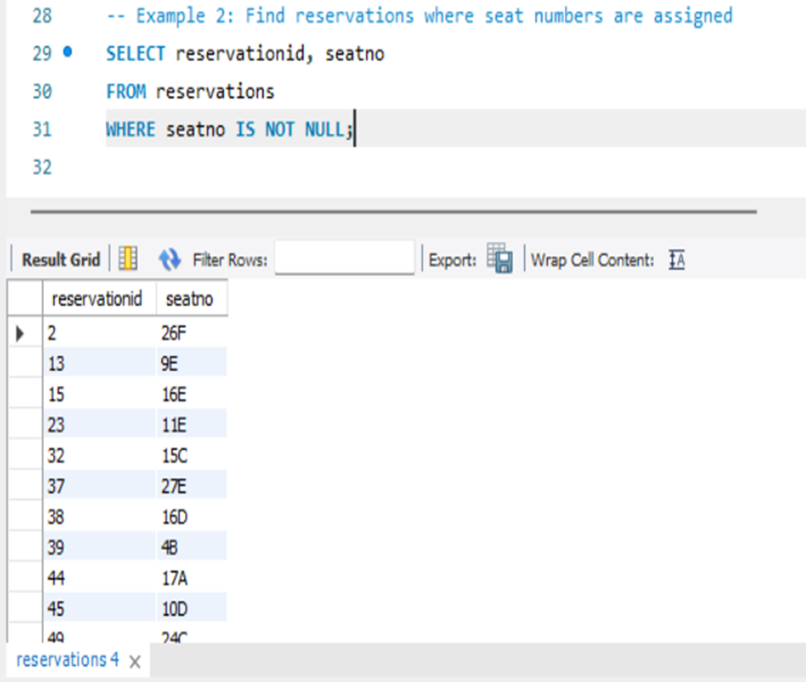
IS NULL/IS NOT NULL
Q. Find passengers who have not given phone no.
Q. Find reservations where seat nos. are assigned
02.
01.
Page 16

Slide 17
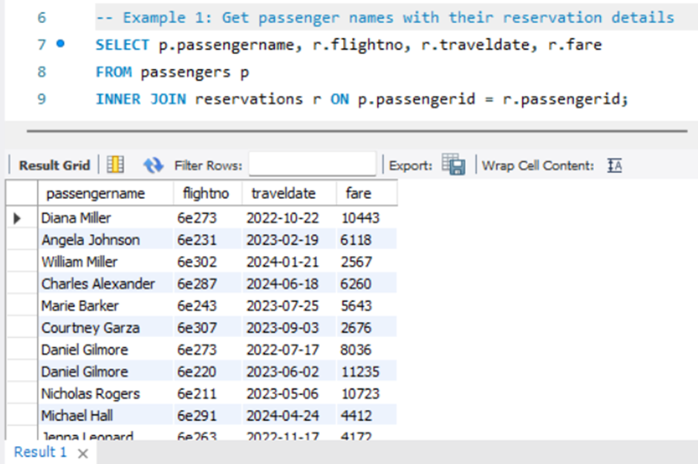
Q. Get passengers names with their reservation detail
JOINS
Contact
INNER JOIN
JOINS
IN
SQL
Page 17

Slide 18
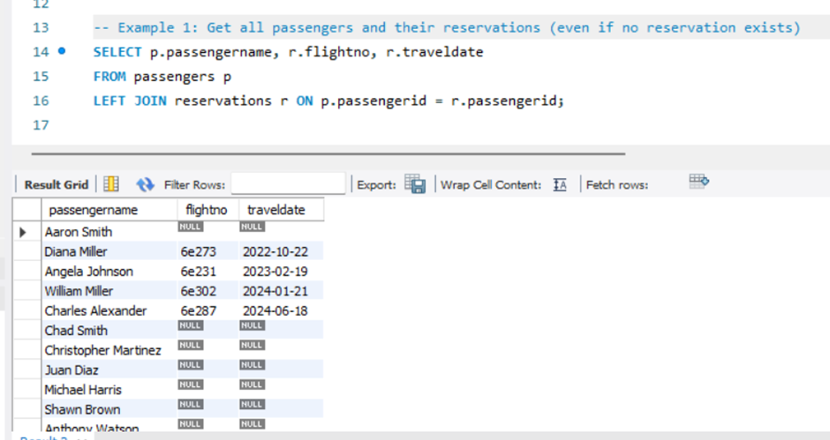
LEFT JOIN
Q. Get all passengers and their reservations
Page 18

Slide 19
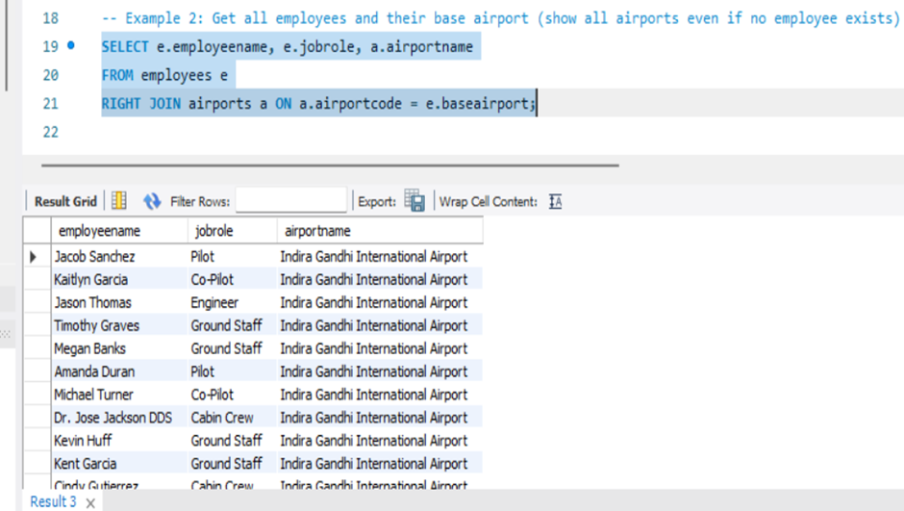
RIGHT JOIN
Q. Get all employees and their Base airport
01.
Page 19

Slide 20
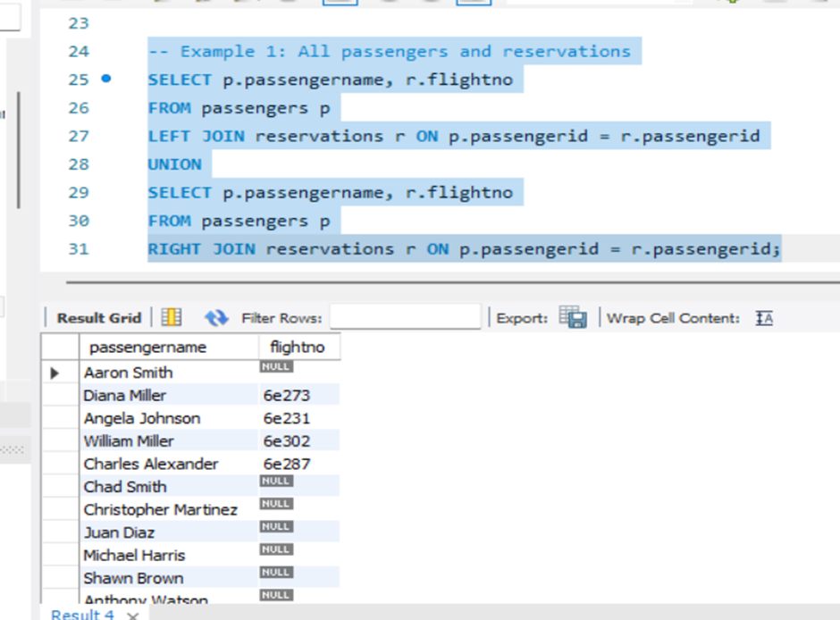
FULL JOIN
Q. All passengers and their reservations
Page 20

Slide 21
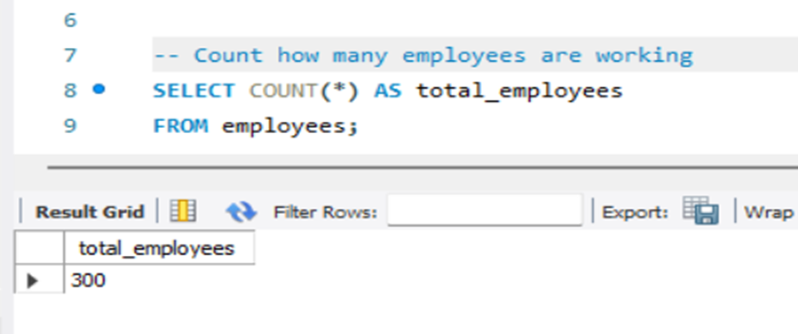
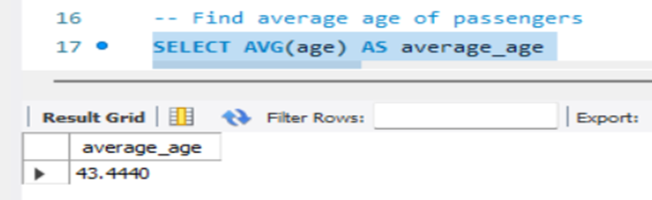
AGGREGATIONS
COUNT()
AVG()
Q. Count how many employees are working
Q.Find average age of passengers
Page 21

Slide 22
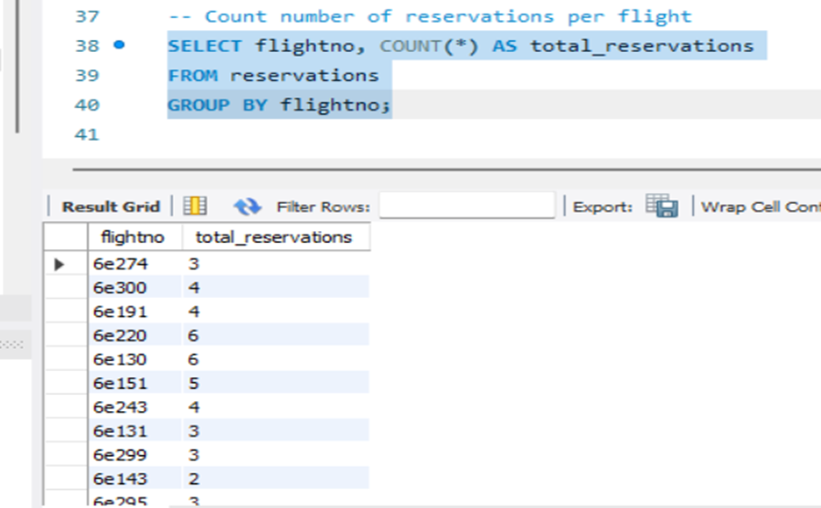
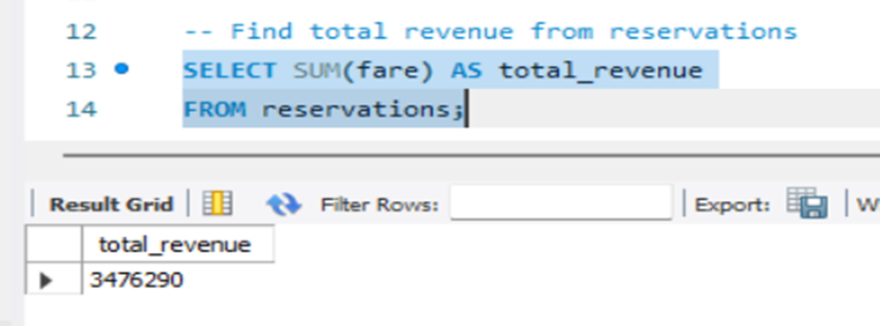
SUM()
GROUP BY
Q. Find total revenue from reservations
Q. Count no. of reservations per flight
Page 22

Slide 23
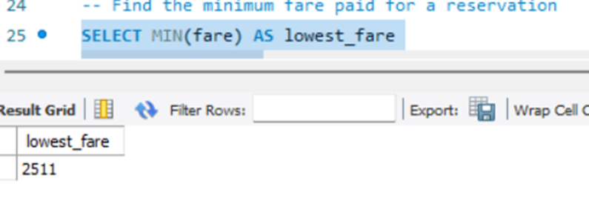
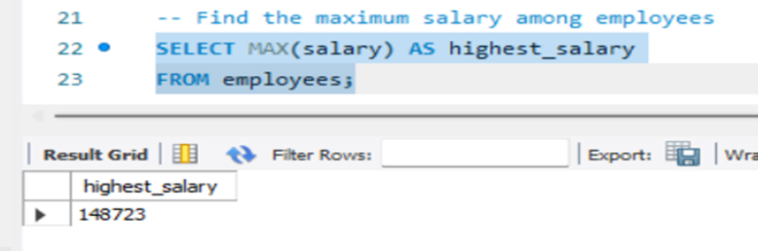
MIN()
MAX()
Q. Find minimum fare paid for a reservations
Q. Find maximum salary among employees
Page 23

Slide 24
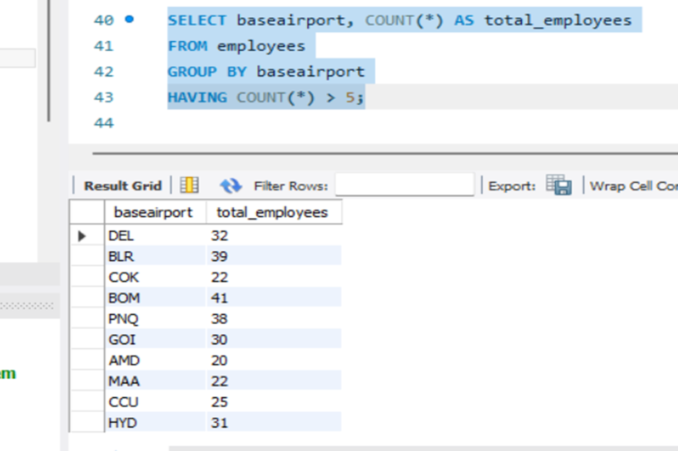
HAVING
Q. Airports with more than 5 employees based there
Page 24

Slide 25
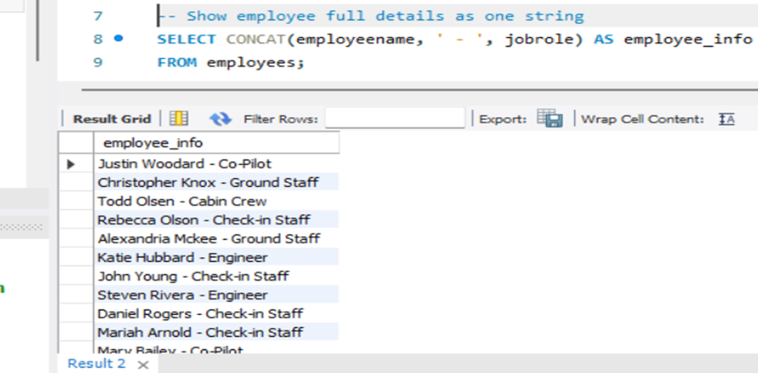
ADVANCED FUNCTIONS-STRING FUNCTIONS
CONCAT()
Q. Show employees full details as one string
Page 25

Slide 26
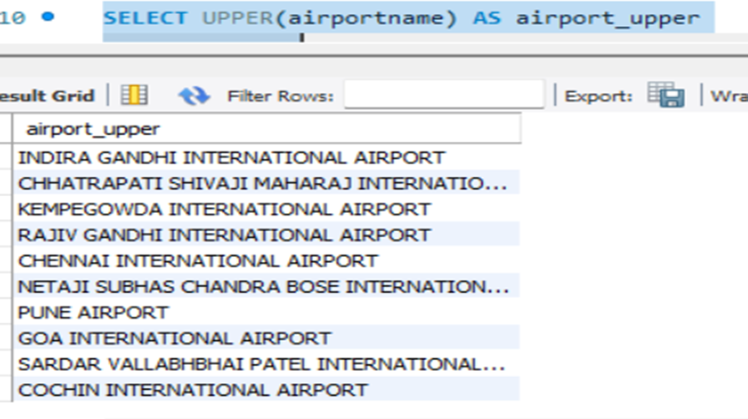
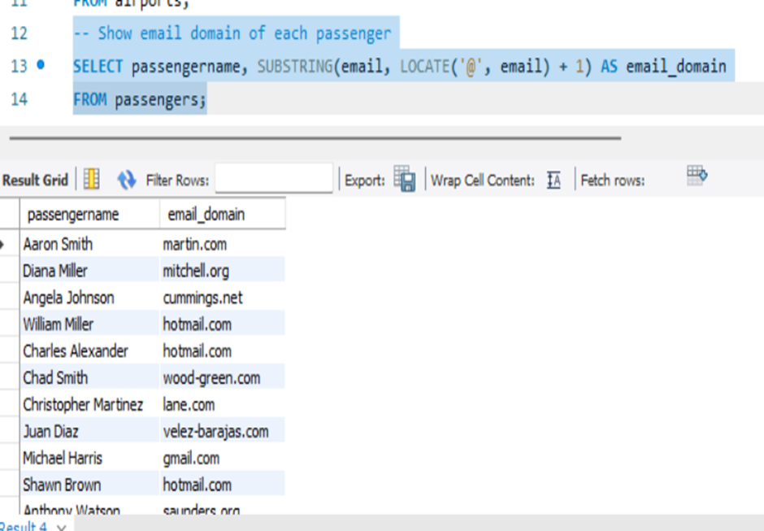
UPPER/LOWER()
SUBSTRING()
Q. Show every airport name in upper case
Q. Show email domain of each passenger
Page 26

Slide 27
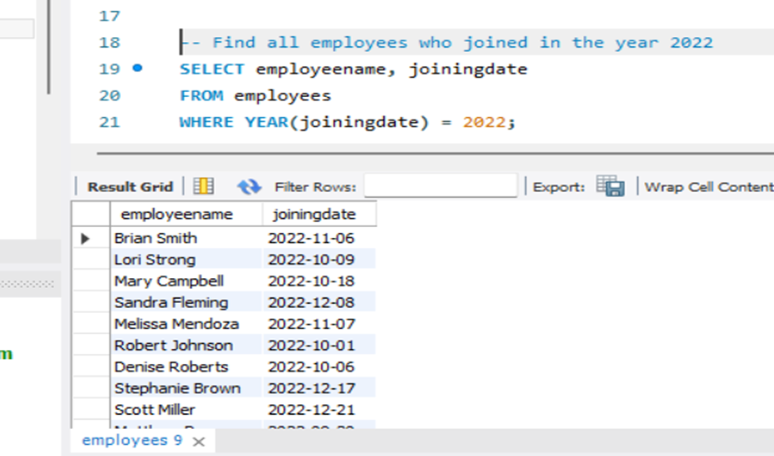
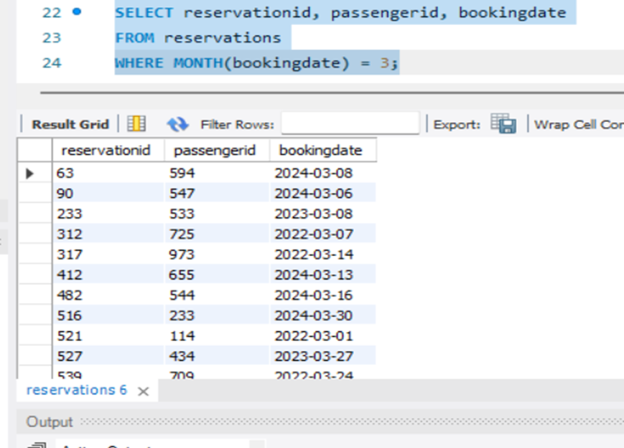
DATE FUNCTIONS
YEAR()
MONTH()
Q.Find all employees who joined in the year 2022
Q.Find all reservations details of month March
Page 27

Slide 28
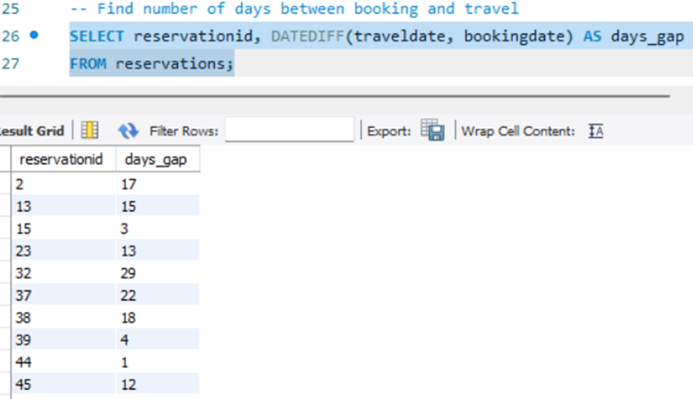
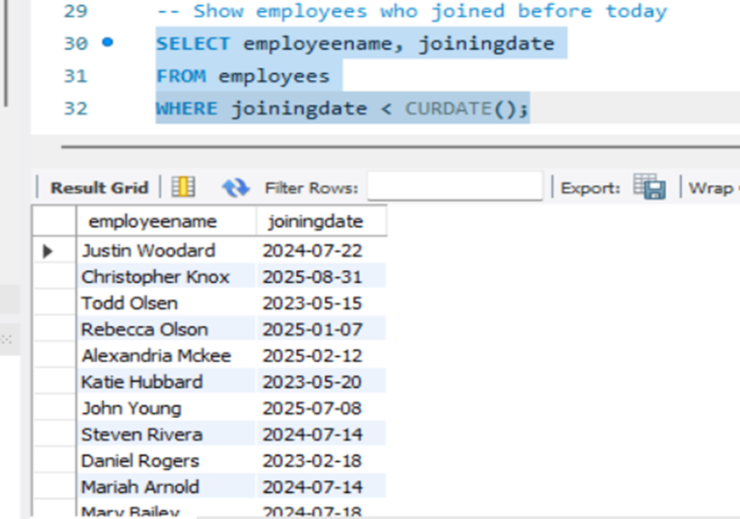
DATEDIFF()
NOW()
Q. find no. of days between bookindate and travel date
Q.Show employees who joined before today
Page 28

Slide 29
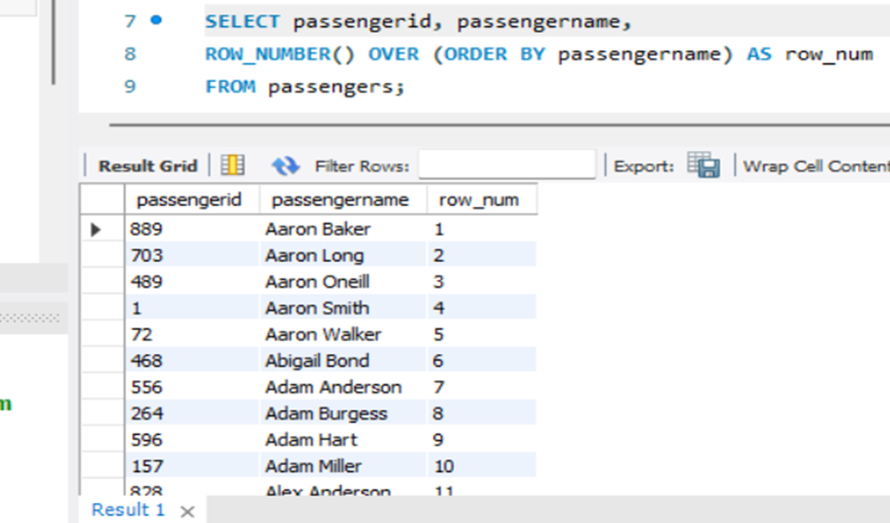
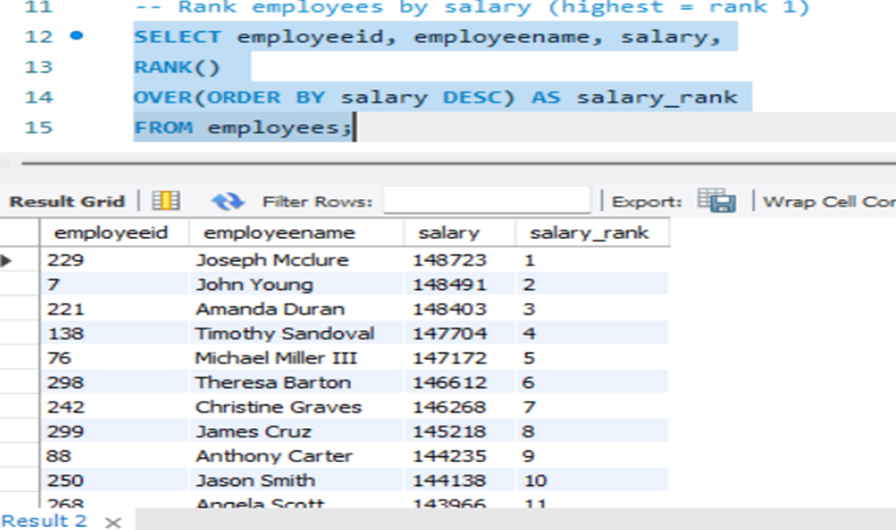
WINDOW FUNCTIONS
ROW NUMBER()
RANK/DENSE RANK()
Q.Assign a unique row number to each passenger ordered by name
Q.Rank employees salary
Page 29

Slide 30
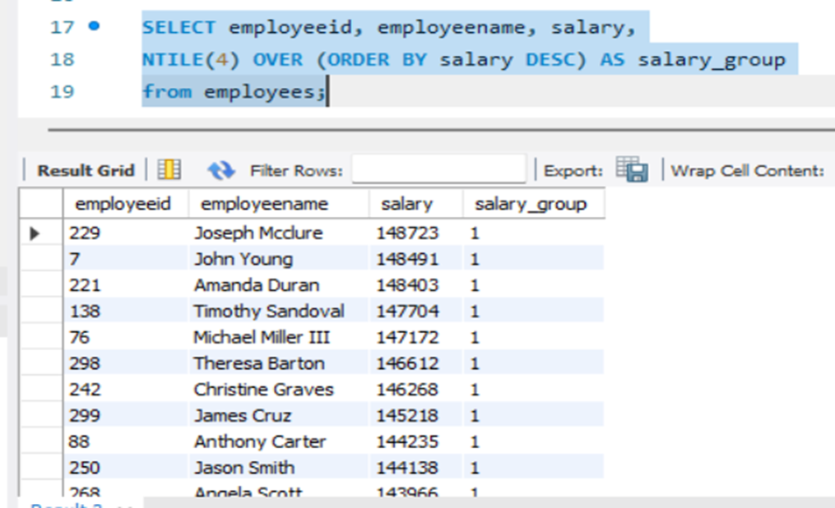
NTILE()
Q. Divide employees into 4 salary groups(quartiles)
Page 30

Slide 31
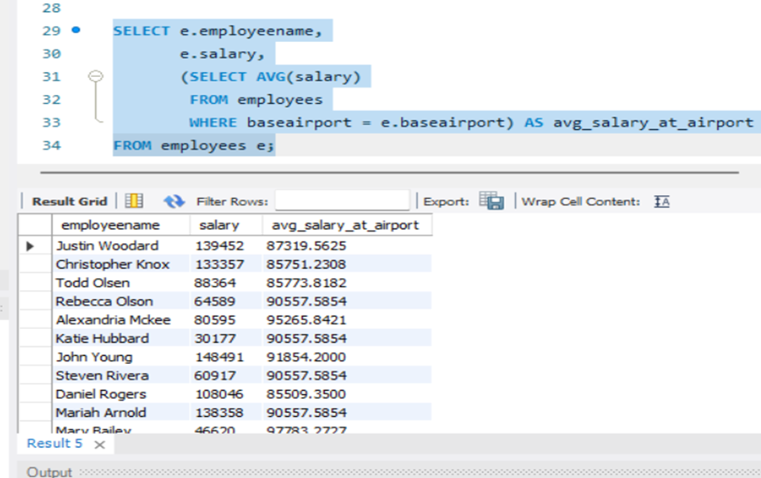
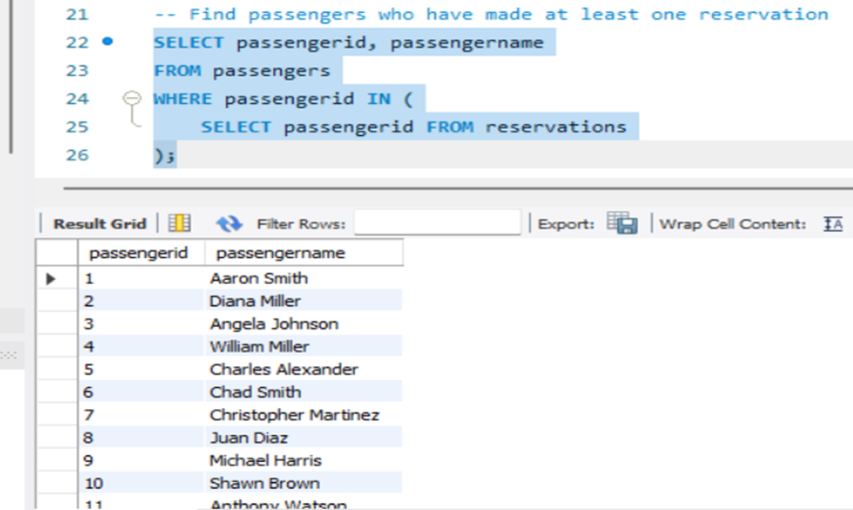
SUBQUERIES
SCALAR SUBQUERY
IN SUBQUERY
Q. Find avg salary of employee at their baseAirport
Q. Find passengers who have made at least one reservation
Page 31

Slide 32
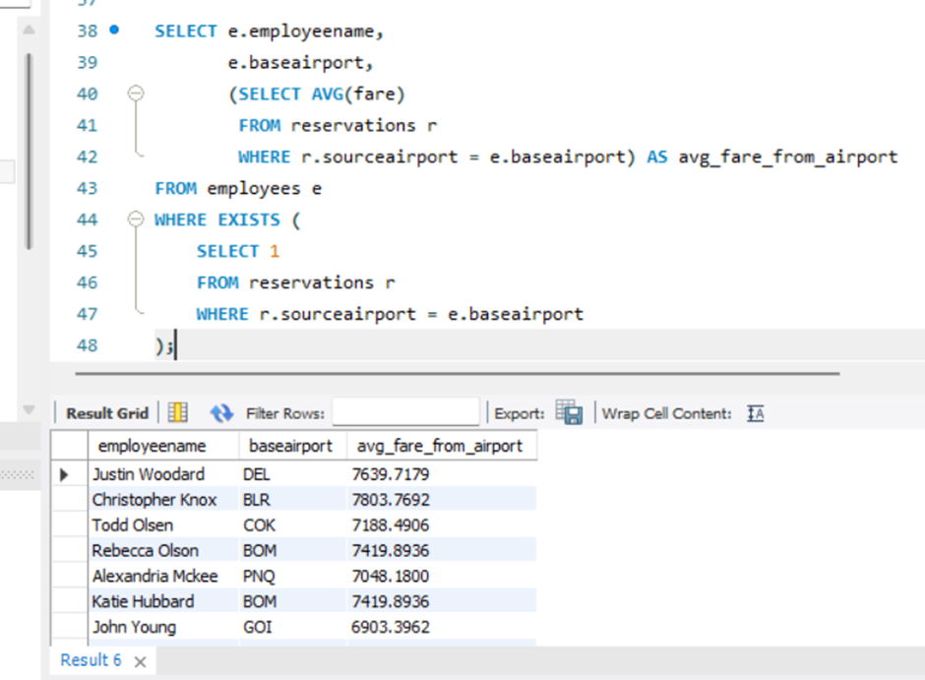
EXISTS SUBQUERY
Q. Find all passengers who have at least one reservation
Page 32

Slide 33
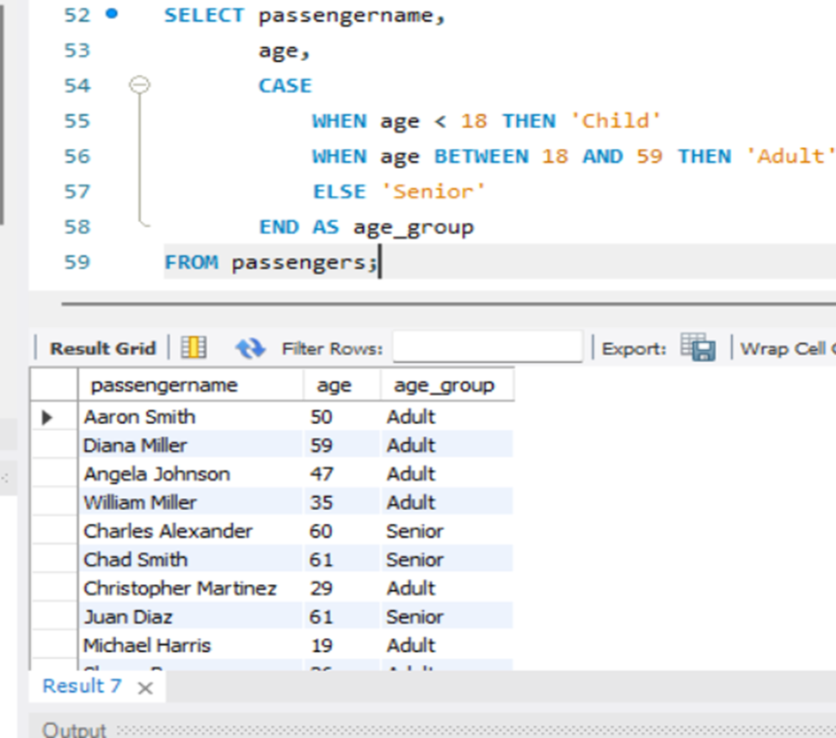
CASE/CONDITINAL LOGIC
Q. Caregorize passengers by Agegroup
Page 33

Slide 34
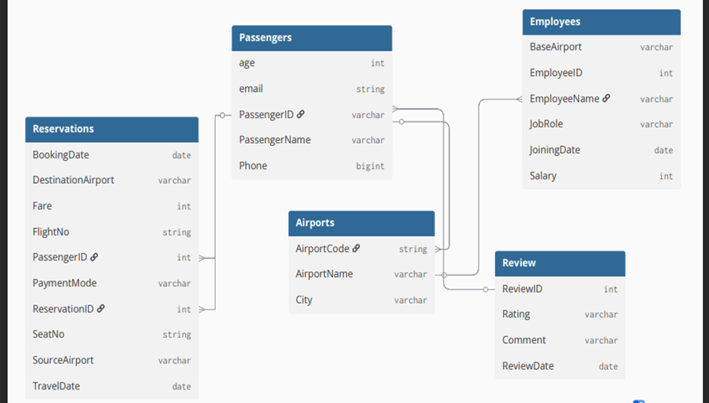
E-R DIAGRAM
Page 34

Slide 35


BUSINESS ANALYSIS AND USE CASES
Business Analysis
1. Market Insight – Helps airlines identify profitable routes and underserved markets.
2. Operational Efficiency – Optimizes flight schedules and reduces costs.
3. Revenue Management – Supports dynamic pricing based on route demand.
4. Customer Experience – Improves route availability and reduces delays.
5. Strategic Planning – Assists in expansion and competitive analysis.
Leading to increased brand relevance and sustainable growth in our market
Page 35

Slide 36


USE CASES
1. Route Planning – Decide which new routes to launch.
2. Flight Scheduling – Optimize departure and arrival timings.
3. Booking Management – Track bookings per route.
4. Demand Analysis – Analyze passenger trends for each route.
5. Performance Monitoring – Track load factor, delays, and revenue per route.
Page 36

Slide 37
CONCLUSION
The Airline Route Map project helps airlines manage and optimize flight routes by analyzing passenger demand, route performance, and operational efficiency. It provides valuable insights for planning new routes, improving existing ones, and making data-driven decisions. By using this project, airlines can optimize schedules, reduce costs, increase revenue, and enhance customer satisfaction, supporting strategic growth and competitiveness in the aviation industry.
Page 37

Slide 38

THANK YOU
FOR YOUR NICE ATTENTION
Page 38

